Slide 1
HOUSE RENT APP USING MERN
TEAM MEMBERS
HARISHESHATHRI.H.B. (211521205049)
HARISHANKARAN.S (211521205048)
JAI PRAKASH.C (211521205055)
KAMALRAJAN.K (211521205059)

Slide 2
ABSTRACT
The demand for easily accessible online platforms for renting properties is growing rapidly. This abstract outlines the development of a House Rent Application using the MERN stack (MongoDB, Express.js, React, and Node.js). The platform will facilitate seamless communication between landlords and tenants, allowing users to browse, list, and rent properties with an efficient and user-friendly interface.

Slide 3
INTRODUCTION
Building a house rent app using the MERN stack leverages the advantages of full-stack JavaScript development, making the app scalable, fast, and dynamic.
MongoDB: A NoSQL database used for storing property data, user profiles, bookings, and other dynamic data.
Express.js: A backend framework that manages HTTP requests, user authentication, and database operations. It provides APIs for CRUD (Create, Read, Update, Delete) operations on properties, users, and payments.
React.js: The frontend JavaScript library that provides a responsive and dynamic user interface (UI). Users can browse properties, filter results, and interact with the platform seamlessly.
Node.js: The runtime environment for executing JavaScript code server-side. It handles backend logic, routes, and real-time data management.

Slide 4
PROPOSED SYSTEM
a) User Registration and Login
New users (landlords or tenants) can register using an email/password or third-party OAuth providers (e.g., Google). Upon registration, the system assigns roles and allows access based on the user type.
b) Listing a Property (Landlord)
A landlord logs in, navigates to the “List a Property” page, fills out details and submits the listing for approval. The admin verifies the listing and makes it publicly available.
c) Searching and Renting (Tenant)
Tenants browse or search for available properties using filters. Upon finding a property, the tenant can contact the landlord and proceed to book the property, including making a payment via the integrated payment system.
d) Payment and Notifications
After payment, the system sends notifications to both tenant and landlord, confirming the transaction. Regular reminders (e.g., upcoming rent due) can be sent to tenants.

Slide 5
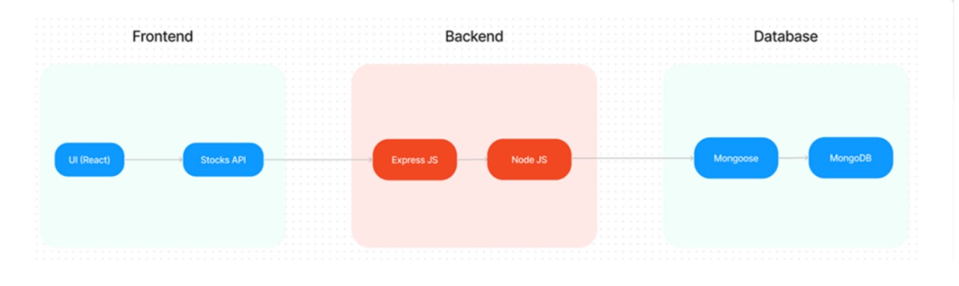
ARCHITECTURE DIAGRAM

Slide 6
FRONT END SERVICES:UI/UX
User Interface: React.js powers a dynamic and interactive user interface for seamless navigation and interaction.
Property Display: Detailed property information, images, and maps are rendered efficiently using React components.
Search Functionality: Advanced search filters and sorting options are implemented with React's state management.

Slide 7
BACKEND INTEGRATION: REACT & NODE JS
API Development: Express.js is used to build RESTful APIs for data access and interaction with the front end.
Data Management: MongoDB provides a flexible and scalable database for storing and retrieving property and user data.
Authentication and Authorization : Node.js handles user authentication and authorization, ensuring secure access to data.
Payment Processing: Integration with payment gateways facilitates secure online transactions for rental payments.

Slide 8
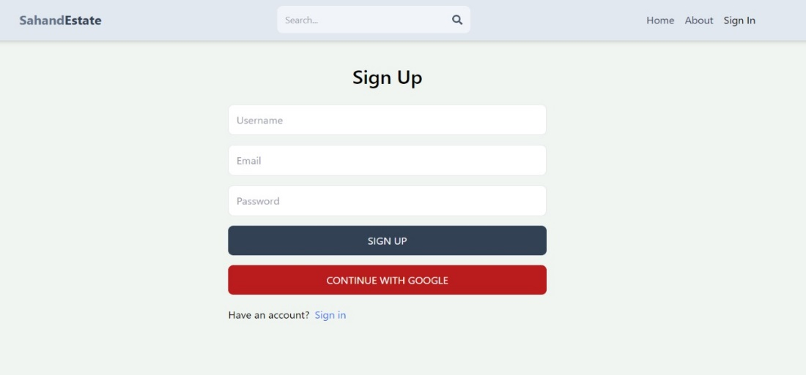
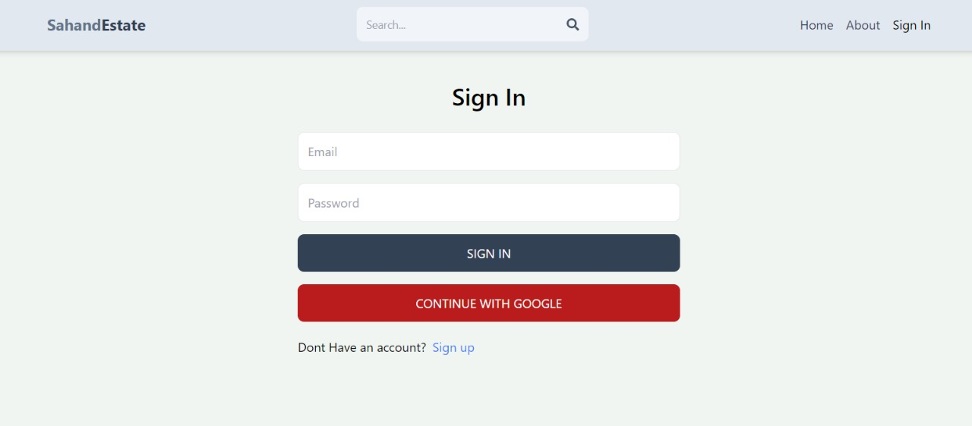
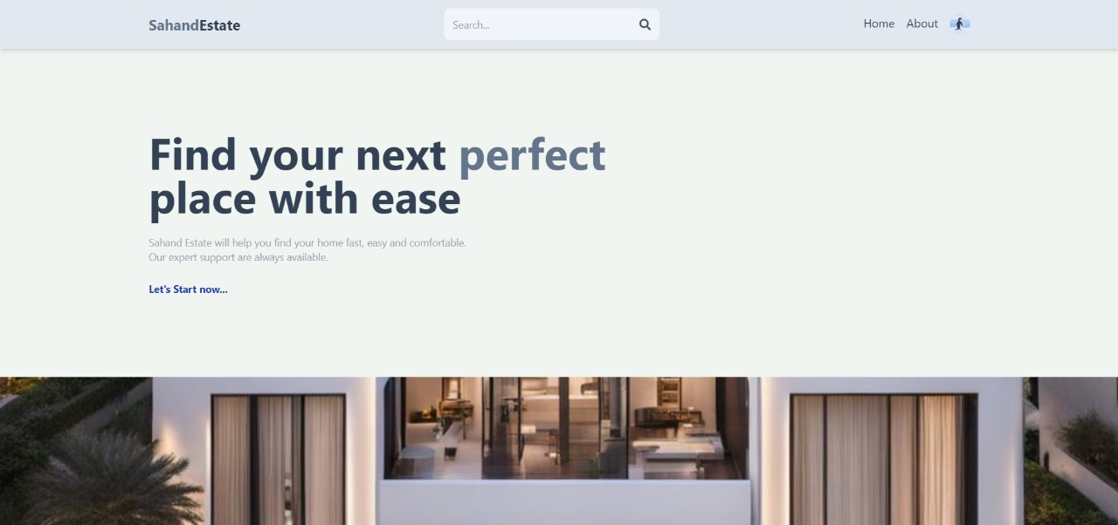
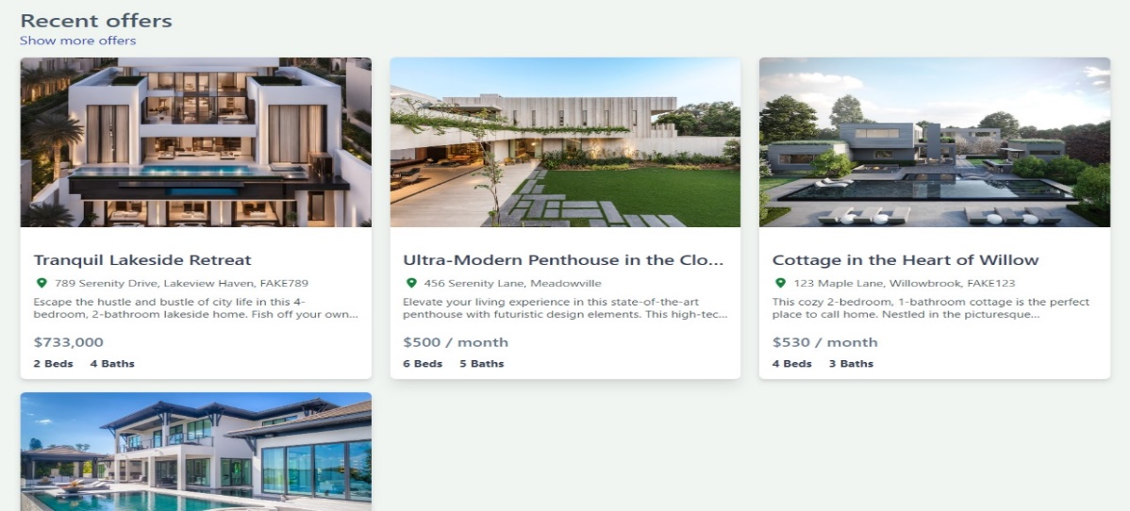
WORKING MODEL

Slide 9
CONCLUSION
The proposed House Rent App using the MERN stack offers a comprehensive and efficient solution for property rental management, bridging the gap between landlords and tenants. By leveraging the power of MongoDB, Express.js, React, and Node.js, the system ensures a fast, scalable, and secure platform that can handle user registrations, property listings, bookings, payments, and communication seamlessly.
The application not only simplifies the property renting process but also enhances user experience by providing easy search, secure transactions, and role-based access controls. Its flexible architecture and modular design allow for future scalability and the addition of new features as the platform evolves.

Slide 10
THANK YOU

